Slide 1
CUSUM charts for monitoring type I right-censored Lognormal lifetime data
중앙대학교 최민재, 이재헌

Slide 2
Introduction
공정관리
연속적으로 진행되는 산업 생산 공정에서 공정의 변동 여부를 관리
품질 특성치를 목표치에 유지시키는 것이 목적
Control Charts - Shewhart Chart – 이전 정보 사용 X, 급격한 변화 감지에 유용
CUSUM & EWMA Chart – 이전 정보 사용 O, 미세한 변화 감지에 유용
최근의 공정관리에 있어서 CUSUM & EWMA 관리도의 사용빈도가 증가

Slide 3
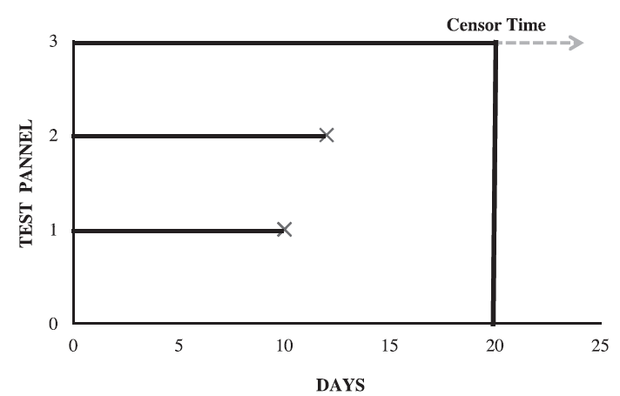
Introduction
중도절단자료
모든 자료들의 실험의 결과를 온전히 알지 못하고
부분적으로 알고 있는 상태
Type I : 특정 시점까지만 실험 진행 후 중지
Type II : 특정 개수의 데이터를 얻은 후 실험 중지

Slide 4
Introduction
중도절단자료
Right censoring
Left censoring
Interval censoring
Type I Right-Censored Data
시작부터 특정 시점까지 실험 진행 후 중지하여 얻은 자료
-> 중도절단자료에 적합한 관리도 운영이 필요

Slide 5
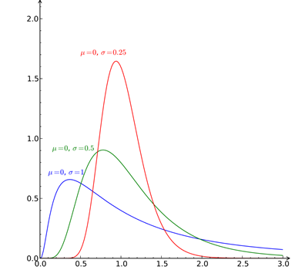

Introduction – Lognormal distribution
Lognormal Distribution
로그 정규분포를 갖는 확률변수 $T$에 로그를 취한 확률변수($Y=log T$)가 정규분포를 따름
$$f\left(t | μ ,σ\right)= \frac{1}{\sqrt{2π }σt}\exp\left(−\frac{{\left(\log{t}−μ\right)}^{2}}{2σ^{2}}\right)$$
$$F\left(t | μ ,σ\right)=Φ\left(\frac{\log{t}−μ}{σ}\right)$$
$E\left(T\right)=\exp\left(μ+\frac{σ^{2}}{2}\right)$, $Var\left(T\right)=exp⁡(2μ+σ^{2})(\exp\left(σ^{2}\right)−1)$
점진적으로 감소하는 긴 우측꼬리를 갖는 확률 분포 형태

Slide 6

Introduction – Lognormal distribution
Lognormal Distribution
$μ$ 감소, $σ$ 고정 -> 평균 감소
$E\left(T\right)=\exp\left(μ+\frac{σ^{2}}{2}\right)의$ 감소를 탐지하는 것은
$μ$의 감소를 탐지하는 것과 동일
$γ=\frac{E_{1}\left(T\right)}{E_{0}\left(T\right)}=\frac{\exp\left(μ_{1}+\frac{σ^{2}}{2}\right)}{\exp\left(μ_{0}+\frac{σ^{2}}{2 }\right)}=\exp{(μ_{1}−μ_{0})}<1$
$→ μ$의 감소를 탐지하는 CUSUM 관리도 절차

Slide 7
Exist Work for Censored Data
- Dickinson et al. (2014)
- Choi and Lee (2016)
- Arif. et al. (2018)

Slide 8
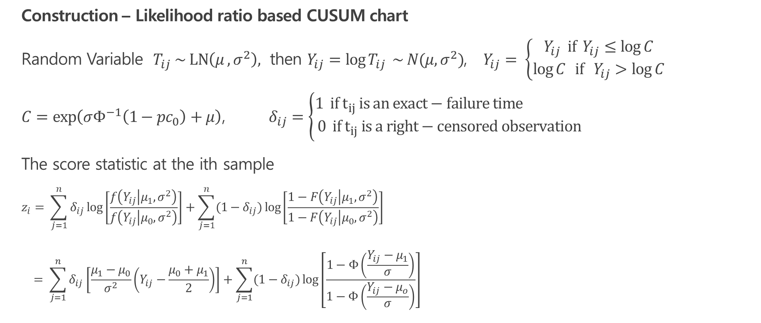
CUSUM Chart for monitoring Lognormal lifetimes
Construction – Likelihood ratio based CUSUM chart
Random Variable $T_{ij} \sim LN\left(μ ,σ^{2}\right),$then $Y_{ij}=\log{T_{ij}} \sim N(μ, σ^{2})$, $Y_{ij}= \left\{\begin{aligned}Y_{ij} if Y_{ij}≤\log{C} \\ \log{C} if Y_{ij}>\log{C}\end{aligned} \right.$
$C=\exp\left(σΦ^{−1}\left(1−pc_{0}\right)+μ\right)$, $δ_{ij}=\left\{\begin{aligned}1 if t_{ij} is an exact−failure time \\ 0 if t_{ij} is a right−censored observation\end{aligned}\right.$
The score statistic at the ith sample
$$z_{i}= \sum_{j=1}^{n}{δ_{ij}\log\left[\frac{f\left(Y_{ij} | μ_{1},σ^{2}\right)}{f\left(Y_{ij} | μ_{0},σ^{2}\right)}\right]}+\sum_{j=1}^{n}{{(1−δ}_{ij})\log\left[\frac{1−F\left(Y_{ij} | μ_{1},σ^{2}\right)}{1−F\left(Y_{ij} | μ_{0},σ^{2}\right)}\right]}$$
$$= \sum_{j=1}^{n}{δ_{ij}\left[\frac{μ_{1}−μ_{0}}{σ^{2}}\left(Y_{ij}−\frac{μ_{0}+μ_{1}}{2}\right)\right]}+\sum_{j=1}^{n}{{(1−δ}_{ij})\log\left[\frac{1−Φ\left(\frac{Y_{ij}−μ_{1}}{σ}\right)}{1−Φ\left(\frac{Y_{ij}−μ_{o}}{σ}\right)}\right]}$$

Slide 9
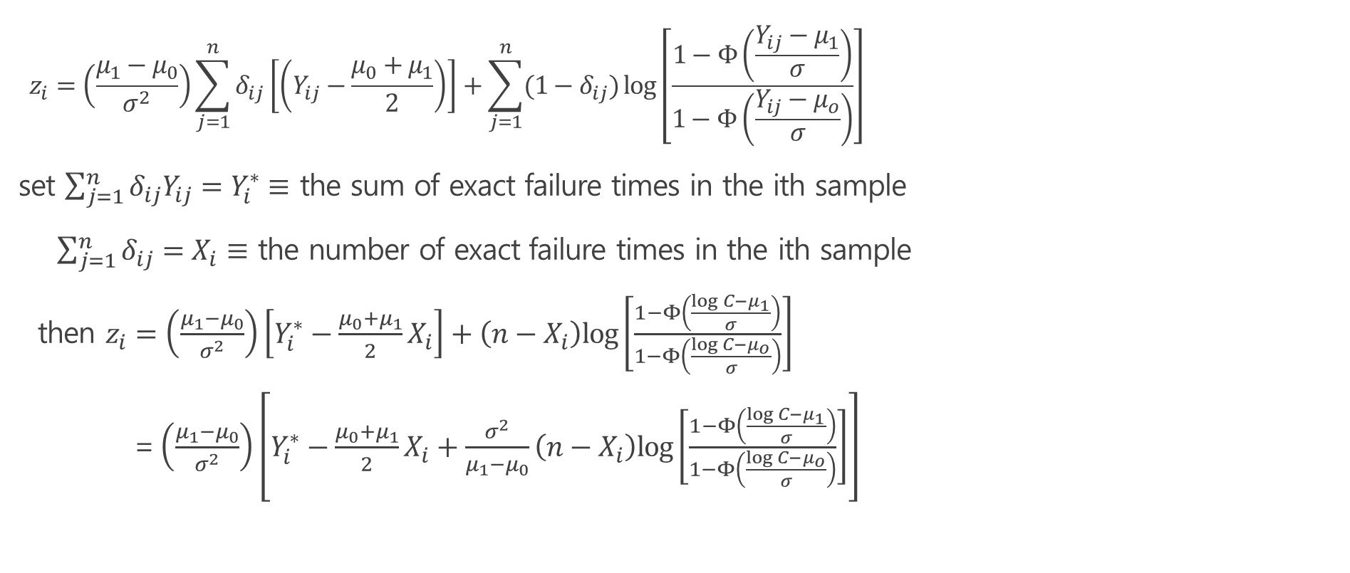
CUSUM Chart for monitoring Lognormal lifetimes
$$z_{i}=\left(\frac{μ_{1}−μ_{0}}{σ^{2}}\right)\sum_{j=1}^{n}{δ_{ij}\left[\left(Y_{ij}−\frac{μ_{0}+μ_{1}}{2}\right)\right]}+\sum_{j=1}^{n}{{(1−δ}_{ij})\log\left[\frac{1−Φ\left(\frac{Y_{ij}−μ_{1}}{σ}\right)}{1−Φ\left(\frac{Y_{ij}−μ_{o}}{σ}\right)}\right]}$$
set $\sum_{j=1}^{n}{δ_{ij}Y_{ij}}=Y_{i}^{∗}≡$ the sum of exact failure times in the ith sample
$\sum_{j=1}^{n}{δ_{ij}}=X_{i}≡$ the number of exact failure times in the ith sample
then $z_{i}=\left(\frac{μ_{1}−μ_{0}}{σ^{2}}\right)\left[Y_{i}^{∗}−\frac{μ_{0}+μ_{1}}{2}X_{i}\right]+\left(n−X_{i}\right)log\left[\frac{1−Φ\left(\frac{\log{C}−μ_{1}}{σ}\right)}{1−Φ\left(\frac{\log{C}−μ_{o}}{σ}\right)}\right]⁡$
= $\left(\frac{μ_{1}−μ_{0}}{σ^{2}}\right)\left[Y_{i}^{∗}−\frac{μ_{0}+μ_{1}}{2}X_{i}+\frac{σ^{2}}{μ_{1}−μ_{0}}\left(n−X_{i}\right)log\left[\frac{1−Φ\left(\frac{\log{C}−μ_{1}}{σ}\right)}{1−Φ\left(\frac{\log{C}−μ_{o}}{σ}\right)}\right]\right]$

Slide 10

CUSUM Chart for monitoring Lognormal lifetimes
$C_{i}^{+}=max\left(0,C_{i−1}^{+}+z_{i}\right) , C_{0}^{+}=0$
Signal if $C_{i}^{+}>{ h}^{+}$
Find $h^{+}$ satisfying ${ARL}_{0}$=370 for given $μ_{0},$ $σ$ and $pc_{0}$

Slide 11
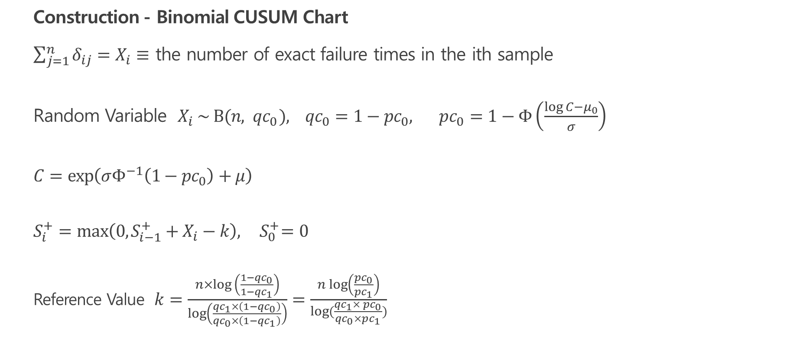
Binomial CUSUM Chart for monitoring lognormal lifetimes
Construction - Binomial CUSUM Chart
$\sum_{j=1}^{n}{δ_{ij}}=X_{i}≡$ the number of exact failure times in the ith sample
Random Variable $X_{i} \sim B(n, { qc}_{0}), {qc}_{0}=1−{pc}_{0},$ $pc_{0}=1−Φ\left(\frac{\log{C}−μ_{0}}{σ}\right)$
$$C=\exp\left(σΦ^{−1}\left(1−pc_{0}\right)+μ\right)$$
$$S_{i}^{+}=max\left(0,S_{i−1}^{+}+X_{i}−k\right),{ S}_{0}^{+}=0$$
Reference Value $k=\frac{n×log \left(\frac{1−{qc}_{0}}{1−{qc}_{1}}\right)}{log\left(\frac{{qc}_{1}×\left(1−{qc}_{0}\right)}{{qc}_{0}×\left(1−{qc}_{1}\right)}\right)}=\frac{n\log\left(\frac{pc_{0}}{pc_{1}}\right)}{\log{(\frac{qc_{1}× pc_{0}}{qc_{0}×pc_{1}})}}$

Slide 12

Binomial CUSUM Chart for monitoring lognormal lifetimes
Signal if${ S}_{i}^{+}$> hs
Find hs satisfying ${ARL}_{0}$=370 for given $μ_{0}$, $σ$ and $qc_{0}$

Slide 13
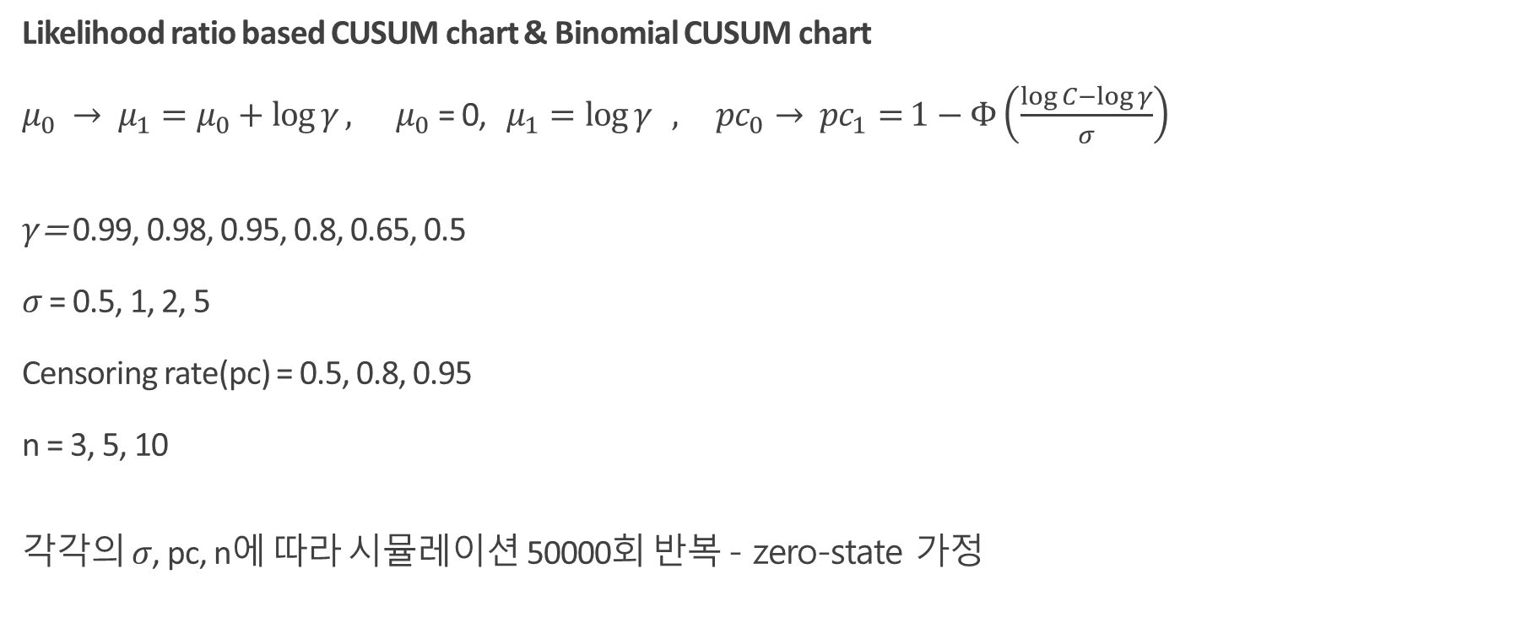
Comparison
Likelihood ratio based CUSUM chart & Binomial CUSUM chart
$μ_{0} → μ_{1}=μ_{0}+\log{γ}, μ_{0}\text{ = 0,} μ_{1}=\log{γ} , {pc}_{0}→ {pc}_{1}=$ $1−Φ\left(\frac{\log{C}−\log{γ}}{σ}\right)$
$γ$= 0.99, 0.98, 0.95, 0.8, 0.65, 0.5
$σ$ = 0.5, 1, 2, 5
Censoring rate(pc) = 0.5, 0.8, 0.95
n = 3, 5, 10
각각의 $σ$, pc, n에 따라 시뮬레이션 50000회 반복 - zero-state 가정

Slide 14

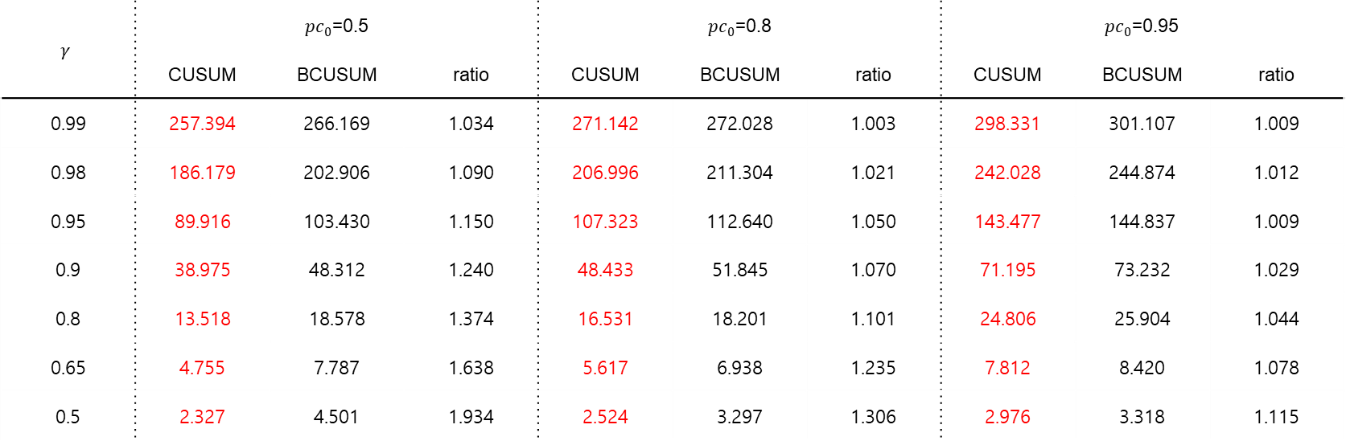
Comparison
Table1. Comparison of the ${ARL}_{1}$ Values for $n=3, σ=0.5$
$$γ$$ | $pc_{0}$=0.5 |  |  | $pc_{0}$=0.8 |  |  | $pc_{0}$=0.95
 | CUSUM | BCUSUM | ratio | CUSUM | BCUSUM | ratio | CUSUM | BCUSUM | ratio
0.99 | 257.394 | 266.169 | 1.034 | 271.142 | 272.028 | 1.003 | 298.331 | 301.107 | 1.009
0.98 | 186.179 | 202.906 | 1.090 | 206.996 | 211.304 | 1.021 | 242.028 | 244.874 | 1.012
0.95 | 89.916 | 103.430 | 1.150 | 107.323 | 112.640 | 1.050 | 143.477 | 144.837 | 1.009
0.9 | 38.975 | 48.312 | 1.240 | 48.433 | 51.845 | 1.070 | 71.195 | 73.232 | 1.029
0.8 | 13.518 | 18.578 | 1.374 | 16.531 | 18.201 | 1.101 | 24.806 | 25.904 | 1.044
0.65 | 4.755 | 7.787 | 1.638 | 5.617 | 6.938 | 1.235 | 7.812 | 8.420 | 1.078
0.5 | 2.327 | 4.501 | 1.934 | 2.524 | 3.297 | 1.306 | 2.976 | 3.318 | 1.115

Slide 15

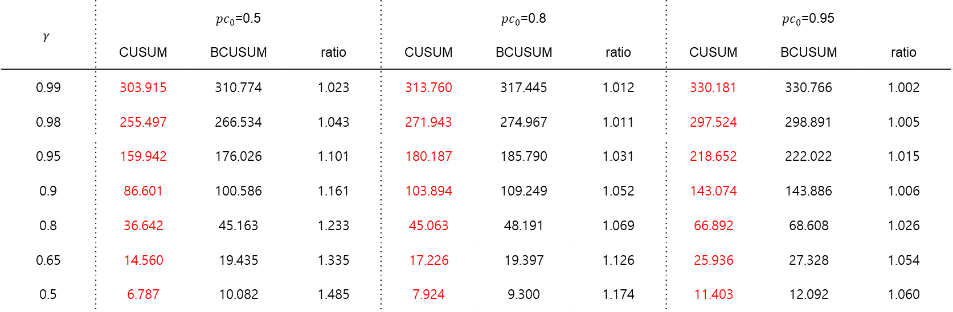
Comparison
Table2. Comparison of the ${ARL}_{1}$ Values for $n=3, σ=1$
$$γ$$ | $pc_{0}$=0.5 |  |  | $pc_{0}$=0.8 |  |  | $pc_{0}$=0.95
 | CUSUM | BCUSUM | ratio | CUSUM | BCUSUM | ratio | CUSUM | BCUSUM | ratio
0.99 | 303.915 | 310.774 | 1.023 | 313.760 | 317.445 | 1.012 | 330.181 | 330.766 | 1.002
0.98 | 255.497 | 266.534 | 1.043 | 271.943 | 274.967 | 1.011 | 297.524 | 298.891 | 1.005
0.95 | 159.942 | 176.026 | 1.101 | 180.187 | 185.790 | 1.031 | 218.652 | 222.022 | 1.015
0.9 | 86.601 | 100.586 | 1.161 | 103.894 | 109.249 | 1.052 | 143.074 | 143.886 | 1.006
0.8 | 36.642 | 45.163 | 1.233 | 45.063 | 48.191 | 1.069 | 66.892 | 68.608 | 1.026
0.65 | 14.560 | 19.435 | 1.335 | 17.226 | 19.397 | 1.126 | 25.936 | 27.328 | 1.054
0.5 | 6.787 | 10.082 | 1.485 | 7.924 | 9.300 | 1.174 | 11.403 | 12.092 | 1.060

Slide 16

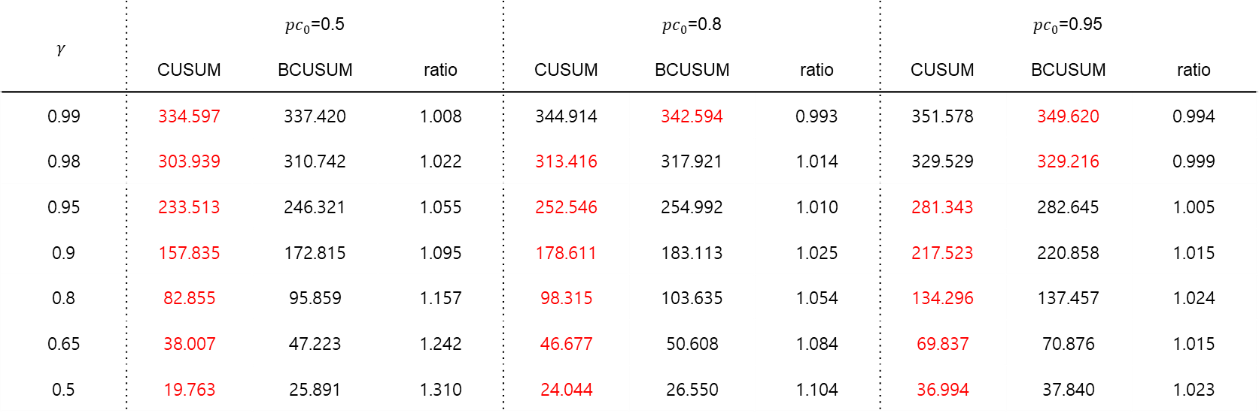
Comparison
Table3. Comparison of the ${ARL}_{1}$ Values for $n=3, σ=2$
$$γ$$ | $pc_{0}$=0.5 |  |  | $pc_{0}$=0.8 |  |  | $pc_{0}$=0.95
 | CUSUM | BCUSUM | ratio | CUSUM | BCUSUM | ratio | CUSUM | BCUSUM | ratio
0.99 | 334.597 | 337.420 | 1.008 | 344.914 | 342.594 | 0.993 | 351.578 | 349.620 | 0.994
0.98 | 303.939 | 310.742 | 1.022 | 313.416 | 317.921 | 1.014 | 329.529 | 329.216 | 0.999
0.95 | 233.513 | 246.321 | 1.055 | 252.546 | 254.992 | 1.010 | 281.343 | 282.645 | 1.005
0.9 | 157.835 | 172.815 | 1.095 | 178.611 | 183.113 | 1.025 | 217.523 | 220.858 | 1.015
0.8 | 82.855 | 95.859 | 1.157 | 98.315 | 103.635 | 1.054 | 134.296 | 137.457 | 1.024
0.65 | 38.007 | 47.223 | 1.242 | 46.677 | 50.608 | 1.084 | 69.837 | 70.876 | 1.015
0.5 | 19.763 | 25.891 | 1.310 | 24.044 | 26.550 | 1.104 | 36.994 | 37.840 | 1.023

Slide 17

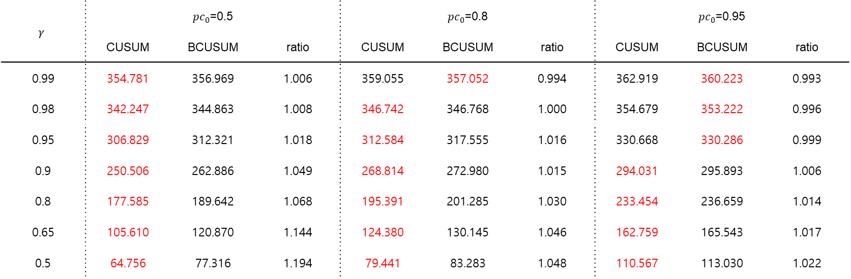
Comparison
Table4. Comparison of the ${ARL}_{1}$ Values for $n=3, σ=5$
$$γ$$ | $pc_{0}$=0.5 |  |  | $pc_{0}$=0.8 |  |  | $pc_{0}$=0.95
 | CUSUM | BCUSUM | ratio | CUSUM | BCUSUM | ratio | CUSUM | BCUSUM | ratio
0.99 | 354.781 | 356.969 | 1.006 | 359.055 | 357.052 | 0.994 | 362.919 | 360.223 | 0.993
0.98 | 342.247 | 344.863 | 1.008 | 346.742 | 346.768 | 1.000 | 354.679 | 353.222 | 0.996
0.95 | 306.829 | 312.321 | 1.018 | 312.584 | 317.555 | 1.016 | 330.668 | 330.286 | 0.999
0.9 | 250.506 | 262.886 | 1.049 | 268.814 | 272.980 | 1.015 | 294.031 | 295.893 | 1.006
0.8 | 177.585 | 189.642 | 1.068 | 195.391 | 201.285 | 1.030 | 233.454 | 236.659 | 1.014
0.65 | 105.610 | 120.870 | 1.144 | 124.380 | 130.145 | 1.046 | 162.759 | 165.543 | 1.017
0.5 | 64.756 | 77.316 | 1.194 | 79.441 | 83.283 | 1.048 | 110.567 | 113.030 | 1.022

Slide 18

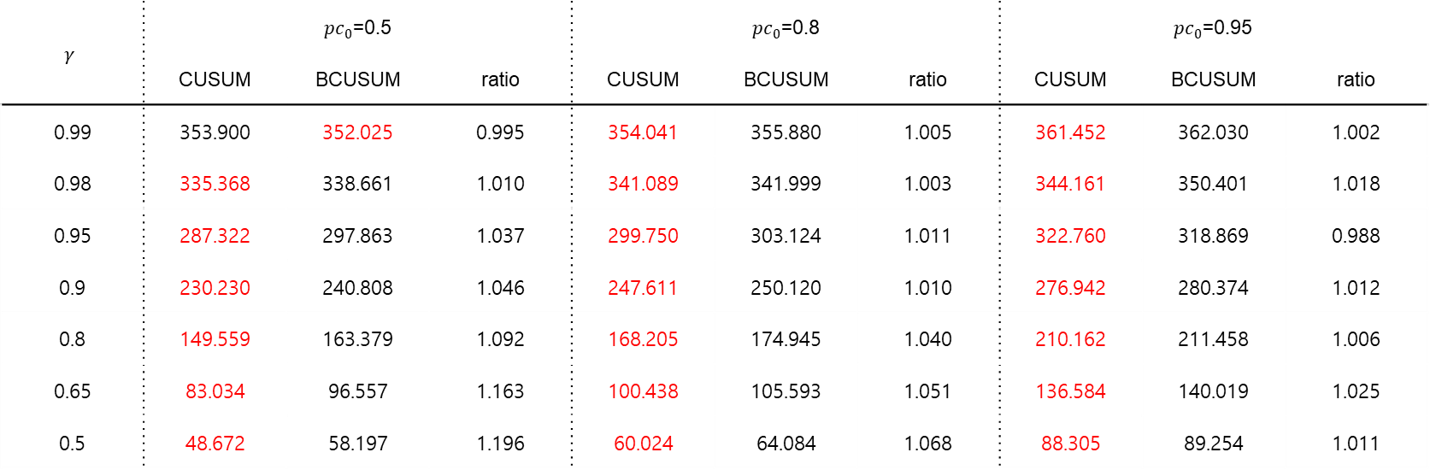
Comparison
Table5. Comparison of the ${ARL}_{1}$ Values for $n=5, σ=5$
$$γ$$ | $pc_{0}$=0.5 |  |  | $pc_{0}$=0.8 |  |  | $pc_{0}$=0.95
 | CUSUM | BCUSUM | ratio | CUSUM | BCUSUM | ratio | CUSUM | BCUSUM | ratio
0.99 | 353.900 | 352.025 | 0.995 | 354.041 | 355.880 | 1.005 | 361.452 | 362.030 | 1.002
0.98 | 335.368 | 338.661 | 1.010 | 341.089 | 341.999 | 1.003 | 344.161 | 350.401 | 1.018
0.95 | 287.322 | 297.863 | 1.037 | 299.750 | 303.124 | 1.011 | 322.760 | 318.869 | 0.988
0.9 | 230.230 | 240.808 | 1.046 | 247.611 | 250.120 | 1.010 | 276.942 | 280.374 | 1.012
0.8 | 149.559 | 163.379 | 1.092 | 168.205 | 174.945 | 1.040 | 210.162 | 211.458 | 1.006
0.65 | 83.034 | 96.557 | 1.163 | 100.438 | 105.593 | 1.051 | 136.584 | 140.019 | 1.025
0.5 | 48.672 | 58.197 | 1.196 | 60.024 | 64.084 | 1.068 | 88.305 | 89.254 | 1.011

Slide 19

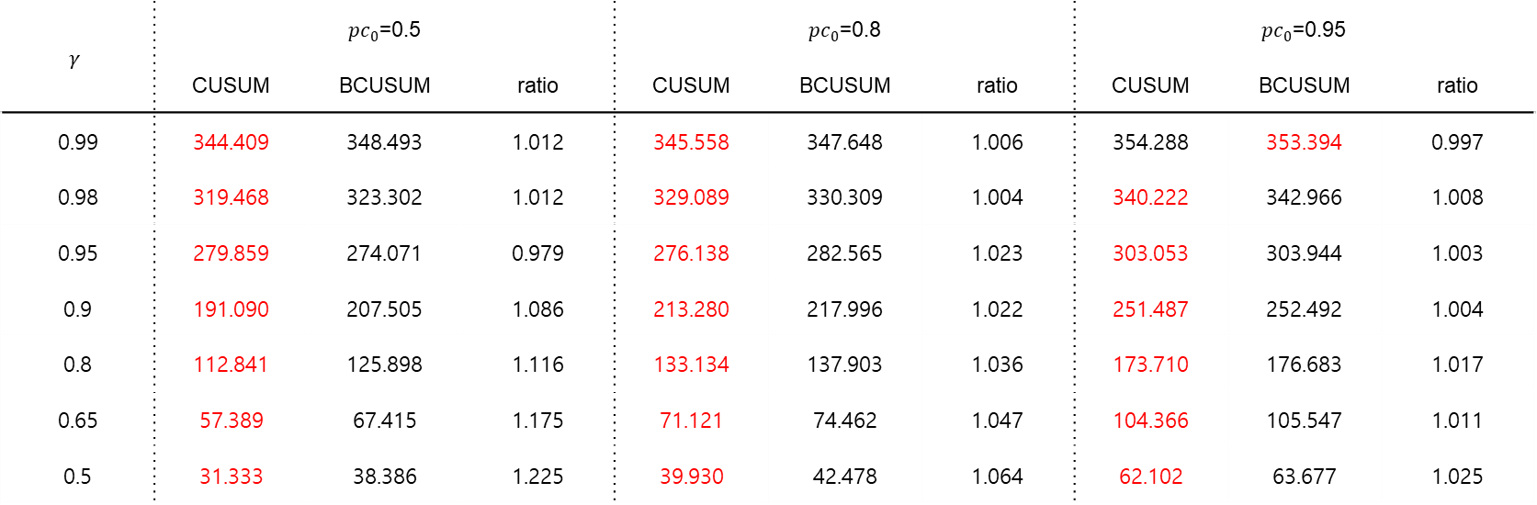
Comparison
Table6. Comparison of the ${ARL}_{1}$ Values for $n=10, σ=5$
$$γ$$ | $pc_{0}$=0.5 |  |  | $pc_{0}$=0.8 |  |  | $pc_{0}$=0.95
 | CUSUM | BCUSUM | ratio | CUSUM | BCUSUM | ratio | CUSUM | BCUSUM | ratio
0.99 | 344.409 | 348.493 | 1.012 | 345.558 | 347.648 | 1.006 | 354.288 | 353.394 | 0.997
0.98 | 319.468 | 323.302 | 1.012 | 329.089 | 330.309 | 1.004 | 340.222 | 342.966 | 1.008
0.95 | 279.859 | 274.071 | 0.979 | 276.138 | 282.565 | 1.023 | 303.053 | 303.944 | 1.003
0.9 | 191.090 | 207.505 | 1.086 | 213.280 | 217.996 | 1.022 | 251.487 | 252.492 | 1.004
0.8 | 112.841 | 125.898 | 1.116 | 133.134 | 137.903 | 1.036 | 173.710 | 176.683 | 1.017
0.65 | 57.389 | 67.415 | 1.175 | 71.121 | 74.462 | 1.047 | 104.366 | 105.547 | 1.011
0.5 | 31.333 | 38.386 | 1.225 | 39.930 | 42.478 | 1.064 | 62.102 | 63.677 | 1.025

Slide 20

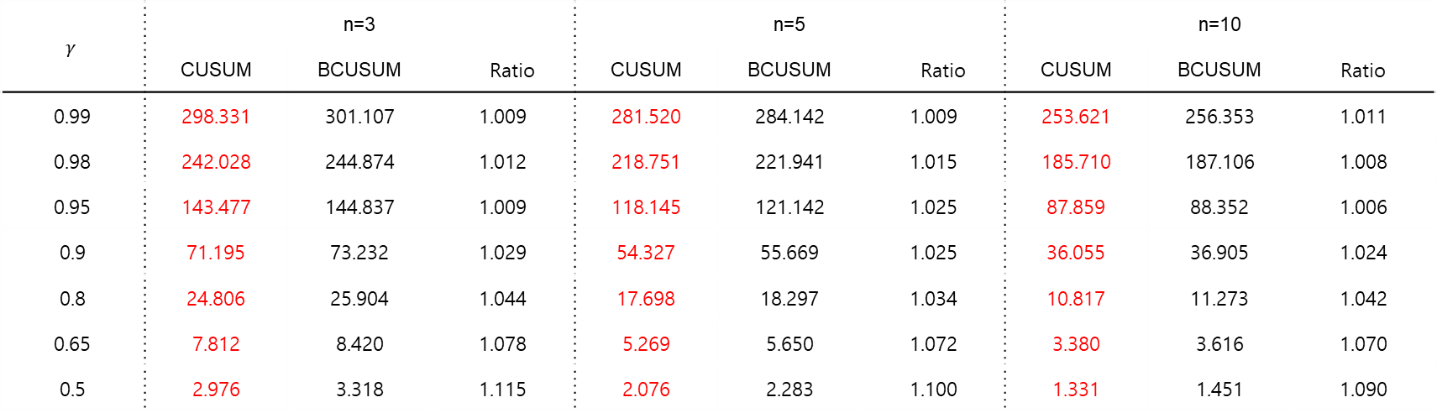
Comparison
Table7. Comparison of the ${ARL}_{1}$ Values for $σ$=0.5, $pc_{0}$=0.95
$$γ$$ | n=3 |  |  | n=5 |  |  | n=10
 | CUSUM | BCUSUM | Ratio | CUSUM | BCUSUM | Ratio | CUSUM | BCUSUM | Ratio
0.99 | 298.331 | 301.107 | 1.009 | 281.520 | 284.142 | 1.009 | 253.621 | 256.353 | 1.011
0.98 | 242.028 | 244.874 | 1.012 | 218.751 | 221.941 | 1.015 | 185.710 | 187.106 | 1.008
0.95 | 143.477 | 144.837 | 1.009 | 118.145 | 121.142 | 1.025 | 87.859 | 88.352 | 1.006
0.9 | 71.195 | 73.232 | 1.029 | 54.327 | 55.669 | 1.025 | 36.055 | 36.905 | 1.024
0.8 | 24.806 | 25.904 | 1.044 | 17.698 | 18.297 | 1.034 | 10.817 | 11.273 | 1.042
0.65 | 7.812 | 8.420 | 1.078 | 5.269 | 5.650 | 1.072 | 3.380 | 3.616 | 1.070
0.5 | 2.976 | 3.318 | 1.115 | 2.076 | 2.283 | 1.100 | 1.331 | 1.451 | 1.090

Slide 21

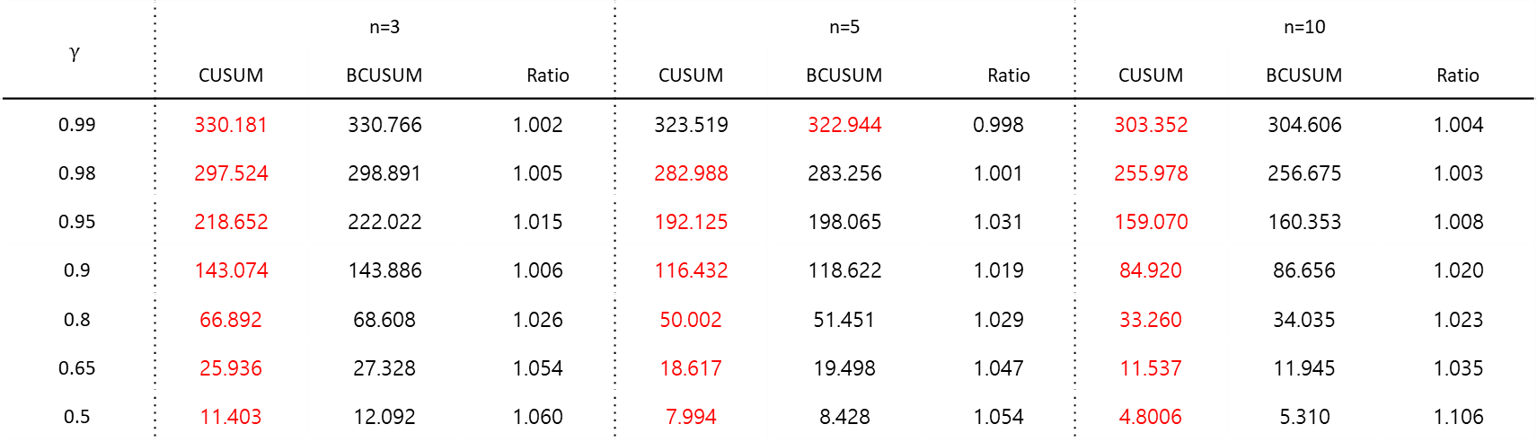
Comparison
Table8. Comparison of the ${ARL}_{1}$ Values for $σ$=1, $pc_{0}$=0.95
$$γ$$ | n=3 |  |  | n=5 |  |  | n=10
 | CUSUM | BCUSUM | Ratio | CUSUM | BCUSUM | Ratio | CUSUM | BCUSUM | Ratio
0.99 | 330.181 | 330.766 | 1.002 | 323.519 | 322.944 | 0.998 | 303.352 | 304.606 | 1.004
0.98 | 297.524 | 298.891 | 1.005 | 282.988 | 283.256 | 1.001 | 255.978 | 256.675 | 1.003
0.95 | 218.652 | 222.022 | 1.015 | 192.125 | 198.065 | 1.031 | 159.070 | 160.353 | 1.008
0.9 | 143.074 | 143.886 | 1.006 | 116.432 | 118.622 | 1.019 | 84.920 | 86.656 | 1.020
0.8 | 66.892 | 68.608 | 1.026 | 50.002 | 51.451 | 1.029 | 33.260 | 34.035 | 1.023
0.65 | 25.936 | 27.328 | 1.054 | 18.617 | 19.498 | 1.047 | 11.537 | 11.945 | 1.035
0.5 | 11.403 | 12.092 | 1.060 | 7.994 | 8.428 | 1.054 | 4.8006 | 5.310 | 1.106

Slide 22

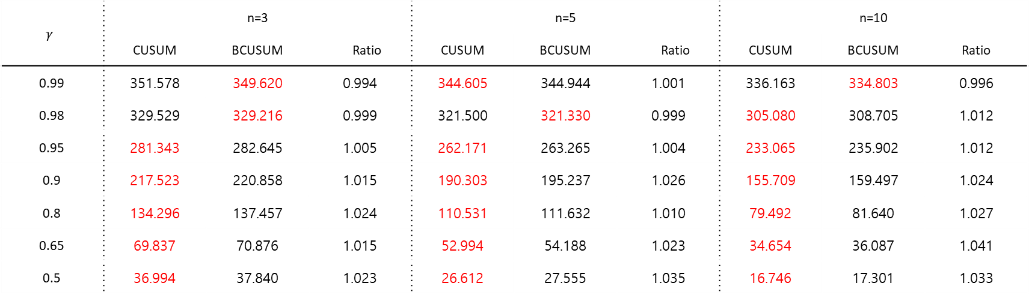
Comparison
Table9. Comparison of the ${ARL}_{1}$ Values for $σ$=2, $pc_{0}$=0.95
$$γ$$ | n=3 |  |  | n=5 |  |  | n=10
 | CUSUM | BCUSUM | Ratio | CUSUM | BCUSUM | Ratio | CUSUM | BCUSUM | Ratio
0.99 | 351.578 | 349.620 | 0.994 | 344.605 | 344.944 | 1.001 | 336.163 | 334.803 | 0.996
0.98 | 329.529 | 329.216 | 0.999 | 321.500 | 321.330 | 0.999 | 305.080 | 308.705 | 1.012
0.95 | 281.343 | 282.645 | 1.005 | 262.171 | 263.265 | 1.004 | 233.065 | 235.902 | 1.012
0.9 | 217.523 | 220.858 | 1.015 | 190.303 | 195.237 | 1.026 | 155.709 | 159.497 | 1.024
0.8 | 134.296 | 137.457 | 1.024 | 110.531 | 111.632 | 1.010 | 79.492 | 81.640 | 1.027
0.65 | 69.837 | 70.876 | 1.015 | 52.994 | 54.188 | 1.023 | 34.654 | 36.087 | 1.041
0.5 | 36.994 | 37.840 | 1.023 | 26.612 | 27.555 | 1.035 | 16.746 | 17.301 | 1.033

Slide 23

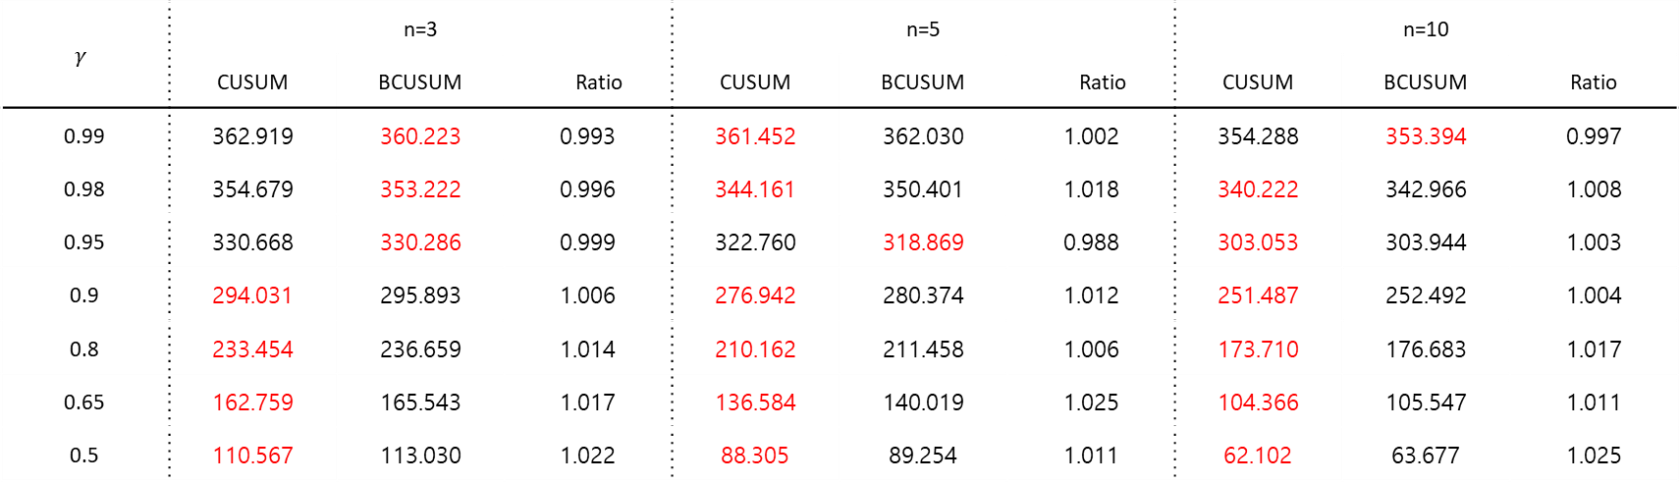
Comparison
Table10. Comparison of the ${ARL}_{1}$ Values for $σ$=5, $pc_{0}$=0.95
$$γ$$ | n=3 |  |  | n=5 |  |  | n=10
 | CUSUM | BCUSUM | Ratio | CUSUM | BCUSUM | Ratio | CUSUM | BCUSUM | Ratio
0.99 | 362.919 | 360.223 | 0.993 | 361.452 | 362.030 | 1.002 | 354.288 | 353.394 | 0.997
0.98 | 354.679 | 353.222 | 0.996 | 344.161 | 350.401 | 1.018 | 340.222 | 342.966 | 1.008
0.95 | 330.668 | 330.286 | 0.999 | 322.760 | 318.869 | 0.988 | 303.053 | 303.944 | 1.003
0.9 | 294.031 | 295.893 | 1.006 | 276.942 | 280.374 | 1.012 | 251.487 | 252.492 | 1.004
0.8 | 233.454 | 236.659 | 1.014 | 210.162 | 211.458 | 1.006 | 173.710 | 176.683 | 1.017
0.65 | 162.759 | 165.543 | 1.017 | 136.584 | 140.019 | 1.025 | 104.366 | 105.547 | 1.011
0.5 | 110.567 | 113.030 | 1.022 | 88.305 | 89.254 | 1.011 | 62.102 | 63.677 | 1.025

Slide 24

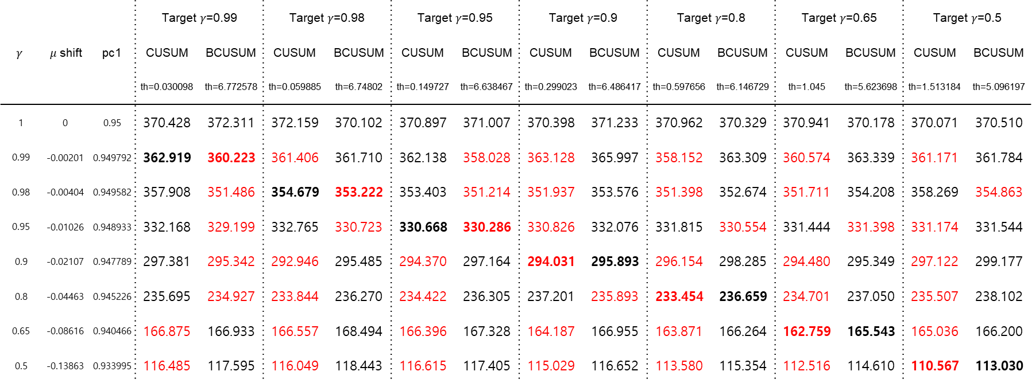
Comparison
Table11. Comparison of the ${ARL}_{1}$ Values for n=3, $σ$=5, $pc_{0}$=0.95
 |  |  | Target $γ$=0.99 |  | Target $γ$=0.98 |  | Target $γ$=0.95 |  | Target $γ$=0.9 |  | Target $γ$=0.8 |  | Target $γ$=0.65 |  | Target $γ$=0.5
$$γ$$ | $μ$ shift | pc1 | CUSUM | BCUSUM | CUSUM | BCUSUM | CUSUM | BCUSUM | CUSUM | BCUSUM | CUSUM | BCUSUM | CUSUM | BCUSUM | CUSUM | BCUSUM
 |  |  | th=0.030098 | th=6.772578 | th=0.059885 | th=6.74802 | th=0.149727 | th=6.638467 | th=0.299023 | th=6.486417 | th=0.597656 | th=6.146729 | th=1.045 | th=5.623698 | th=1.513184 | th=5.096197
1 | 0 | 0.95 | 370.428 | 372.311 | 372.159 | 370.102 | 370.897 | 371.007 | 370.398 | 371.233 | 370.962 | 370.329 | 370.941 | 370.178 | 370.071 | 370.510
0.99 | -0.00201 | 0.949792 | 362.919 | 360.223 | 361.406 | 361.710 | 362.138 | 358.028 | 363.128 | 365.997 | 358.152 | 363.309 | 360.574 | 363.339 | 361.171 | 361.784
0.98 | -0.00404 | 0.949582 | 357.908 | 351.486 | 354.679 | 353.222 | 353.403 | 351.214 | 351.937 | 353.576 | 351.398 | 352.674 | 351.711 | 354.208 | 358.269 | 354.863
0.95 | -0.01026 | 0.948933 | 332.168 | 329.199 | 332.765 | 330.723 | 330.668 | 330.286 | 330.826 | 332.076 | 331.815 | 330.554 | 331.444 | 331.398 | 331.174 | 331.544
0.9 | -0.02107 | 0.947789 | 297.381 | 295.342 | 292.946 | 295.485 | 294.370 | 297.164 | 294.031 | 295.893 | 296.154 | 298.285 | 294.480 | 295.349 | 297.122 | 299.177
0.8 | -0.04463 | 0.945226 | 235.695 | 234.927 | 233.844 | 236.270 | 234.422 | 236.305 | 237.201 | 235.893 | 233.454 | 236.659 | 234.701 | 237.050 | 235.507 | 238.102
0.65 | -0.08616 | 0.940466 | 166.875 | 166.933 | 166.557 | 168.494 | 166.396 | 167.328 | 164.187 | 166.955 | 163.871 | 166.264 | 162.759 | 165.543 | 165.036 | 166.200
0.5 | -0.13863 | 0.933995 | 116.485 | 117.595 | 116.049 | 118.443 | 116.615 | 117.405 | 115.029 | 116.652 | 113.580 | 115.354 | 112.516 | 114.610 | 110.567 | 113.030

Slide 25

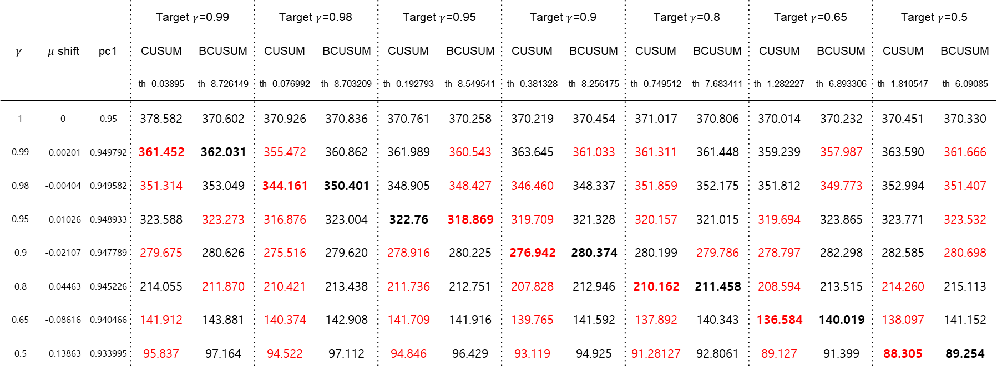
Comparison
Table12. Comparison of the ${ARL}_{1}$ Values for n=5, $σ$=5, $pc_{0}$=0.95
 |  |  | Target $γ$=0.99 |  | Target $γ$=0.98 |  | Target $γ$=0.95 |  | Target $γ$=0.9 |  | Target $γ$=0.8 |  | Target $γ$=0.65 |  | Target $γ$=0.5
$$γ$$ | $μ$ shift | pc1 | CUSUM | BCUSUM | CUSUM | BCUSUM | CUSUM | BCUSUM | CUSUM | BCUSUM | CUSUM | BCUSUM | CUSUM | BCUSUM | CUSUM | BCUSUM
 |  |  | th=0.03895 | th=8.726149 | th=0.076992 | th=8.703209 | th=0.192793 | th=8.549541 | th=0.381328 | th=8.256175 | th=0.749512 | th=7.683411 | th=1.282227 | th=6.893306 | th=1.810547 | th=6.09085
1 | 0 | 0.95 | 378.582 | 370.602 | 370.926 | 370.836 | 370.761 | 370.258 | 370.219 | 370.454 | 371.017 | 370.806 | 370.014 | 370.232 | 370.451 | 370.330
0.99 | -0.00201 | 0.949792 | 361.452 | 362.031 | 355.472 | 360.862 | 361.989 | 360.543 | 363.645 | 361.033 | 361.311 | 361.448 | 359.239 | 357.987 | 363.590 | 361.666
0.98 | -0.00404 | 0.949582 | 351.314 | 353.049 | 344.161 | 350.401 | 348.905 | 348.427 | 346.460 | 348.337 | 351.859 | 352.175 | 351.812 | 349.773 | 352.994 | 351.407
0.95 | -0.01026 | 0.948933 | 323.588 | 323.273 | 316.876 | 323.004 | 322.76 | 318.869 | 319.709 | 321.328 | 320.157 | 321.015 | 319.694 | 323.865 | 323.771 | 323.532
0.9 | -0.02107 | 0.947789 | 279.675 | 280.626 | 275.516 | 279.620 | 278.916 | 280.225 | 276.942 | 280.374 | 280.199 | 279.786 | 278.797 | 282.298 | 282.585 | 280.698
0.8 | -0.04463 | 0.945226 | 214.055 | 211.870 | 210.421 | 213.438 | 211.736 | 212.751 | 207.828 | 212.946 | 210.162 | 211.458 | 208.594 | 213.515 | 214.260 | 215.113
0.65 | -0.08616 | 0.940466 | 141.912 | 143.881 | 140.374 | 142.908 | 141.709 | 141.916 | 139.765 | 141.592 | 137.892 | 140.343 | 136.584 | 140.019 | 138.097 | 141.152
0.5 | -0.13863 | 0.933995 | 95.837 | 97.164 | 94.522 | 97.112 | 94.846 | 96.429 | 93.119 | 94.925 | 91.28127 | 92.8061 | 89.127 | 91.399 | 88.305 | 89.254

Slide 26

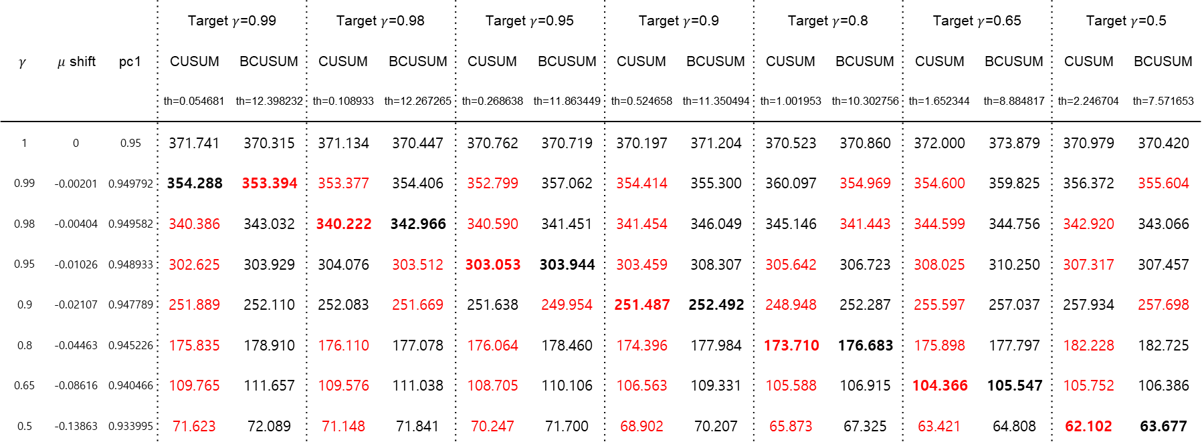
Comparison
Table13. Comparison of the ${ARL}_{1}$ Values for n=10, $σ$=5, $pc_{0}$=0.95
 |  |  | Target $γ$=0.99 |  | Target $γ$=0.98 |  | Target $γ$=0.95 |  | Target $γ$=0.9 |  | Target $γ$=0.8 |  | Target $γ$=0.65 |  | Target $γ$=0.5
$$γ$$ | $μ$ shift | pc1 | CUSUM | BCUSUM | CUSUM | BCUSUM | CUSUM | BCUSUM | CUSUM | BCUSUM | CUSUM | BCUSUM | CUSUM | BCUSUM | CUSUM | BCUSUM
 |  |  | th=0.054681 | th=12.398232 | th=0.108933 | th=12.267265 | th=0.268638 | th=11.863449 | th=0.524658 | th=11.350494 | th=1.001953 | th=10.302756 | th=1.652344 | th=8.884817 | th=2.246704 | th=7.571653
1 | 0 | 0.95 | 371.741 | 370.315 | 371.134 | 370.447 | 370.762 | 370.719 | 370.197 | 371.204 | 370.523 | 370.860 | 372.000 | 373.879 | 370.979 | 370.420
0.99 | -0.00201 | 0.949792 | 354.288 | 353.394 | 353.377 | 354.406 | 352.799 | 357.062 | 354.414 | 355.300 | 360.097 | 354.969 | 354.600 | 359.825 | 356.372 | 355.604
0.98 | -0.00404 | 0.949582 | 340.386 | 343.032 | 340.222 | 342.966 | 340.590 | 341.451 | 341.454 | 346.049 | 345.146 | 341.443 | 344.599 | 344.756 | 342.920 | 343.066
0.95 | -0.01026 | 0.948933 | 302.625 | 303.929 | 304.076 | 303.512 | 303.053 | 303.944 | 303.459 | 308.307 | 305.642 | 306.723 | 308.025 | 310.250 | 307.317 | 307.457
0.9 | -0.02107 | 0.947789 | 251.889 | 252.110 | 252.083 | 251.669 | 251.638 | 249.954 | 251.487 | 252.492 | 248.948 | 252.287 | 255.597 | 257.037 | 257.934 | 257.698
0.8 | -0.04463 | 0.945226 | 175.835 | 178.910 | 176.110 | 177.078 | 176.064 | 178.460 | 174.396 | 177.984 | 173.710 | 176.683 | 175.898 | 177.797 | 182.228 | 182.725
0.65 | -0.08616 | 0.940466 | 109.765 | 111.657 | 109.576 | 111.038 | 108.705 | 110.106 | 106.563 | 109.331 | 105.588 | 106.915 | 104.366 | 105.547 | 105.752 | 106.386
0.5 | -0.13863 | 0.933995 | 71.623 | 72.089 | 71.148 | 71.841 | 70.247 | 71.700 | 68.902 | 70.207 | 65.873 | 67.325 | 63.421 | 64.808 | 62.102 | 63.677

Slide 27

Conclusion
전체적인 관리도의 성능은 $pc_{0}$, $σ$가 커질수록 나빠지며 표본 수가 커질수록 좋아짐
대부분의 경우 CUSUM이 BCUSUM에 대해 성능이 좋게 나타남
Binomial CUSUM : 표본 수가 작고, 실제 변화량이 작고,
$σ의$ 값이 크며 $pc_{0}$의 값이 큰 경우 성능이 좋음
Remarks : $가$용정보량이 많고, $σ의$ 값이 작은 경우 CUSUM의 사용을 권장
가용정보량이 적고, $σ의$ 값이 크며, 미세한 변화를 탐지할 때는 BCUSUM의 사용을 권장

Slide 28
- 끝 -

